Slide 1
Educational Data Mining For Student Performance Prediction
Supervisor : Prof. Dewan Md. Farid
Course Teacher : Prof. Swakkhar Shatabda
Presented By-
Wasi Uddin Bhuyian, 011201286
Khaled Md Mushfique, 011201352
Farzana Akter Nipa, 011201361
Abtahi Ahmed, 011202247
Md Jobaer Sarker Jesan, 011152024

Slide 2
Content
Problem
Statement
Literature
Review
Objectives
Diagrams
Project
Plan
Complex
Engineering
Problems
Motivation
Gap
Analysis
Requirements
Cost
Analysis
Standards
and
Constraints

Slide 3
Problem Statement
Students struggle to find their passion and a suitable career.
Machine learning model that predicts the future performance of students.
Take data from students and predict their grades.

Slide 4
Big Picture

Slide 5
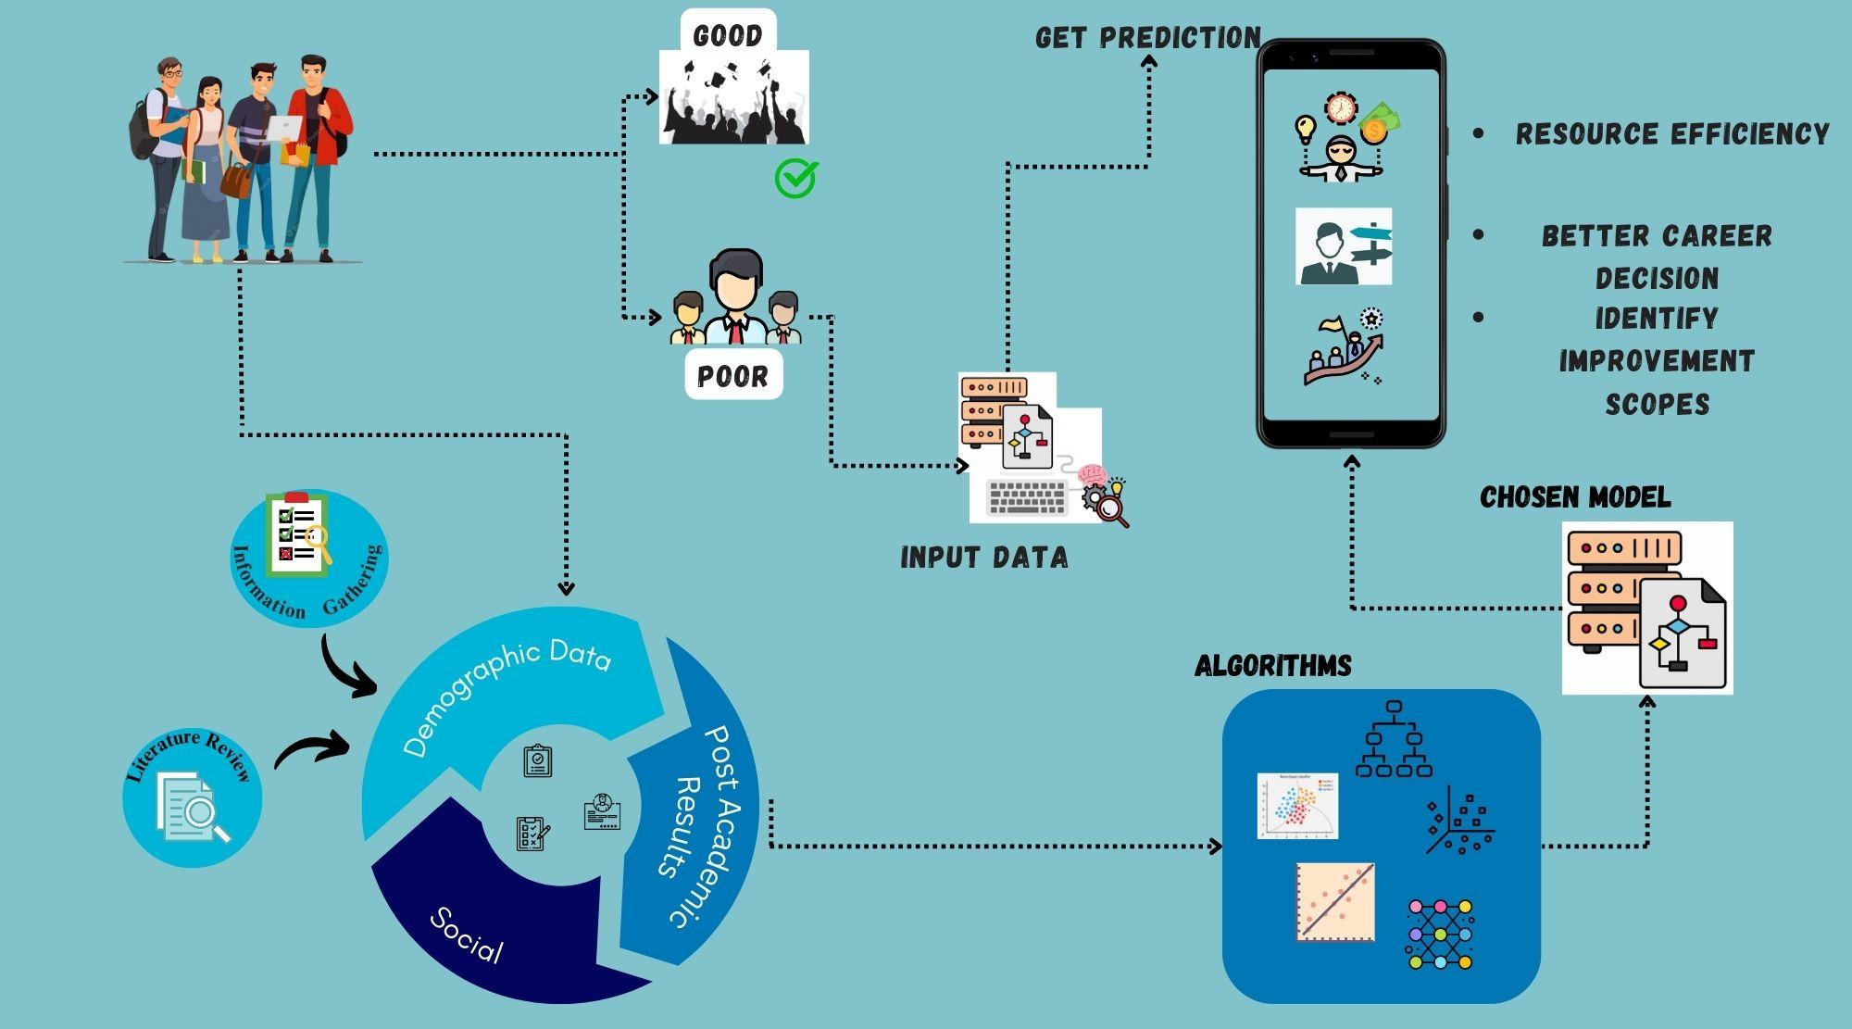

Slide 6
Motivation
Education more accessible due to improved technology.
Various resources available.
Students struggle to find their passion and a suitable career.
In Bangladesh, families force students to take up ‘respectable’ programs .
Students enrol in trending programs.
Late realization and switching of careers, which costs time and money.

Slide 7




Stakeholders
Students
Guardians
Teachers
Institutions

Slide 8
Literature Review Highlights
Educational Data Mining: A Mining Model for Developing Students’ Programming Skills
rf. Pathan et al. (2014)
Educational data mining for predicting students academic performance using machine learning algorithms
rf. Dabhade et al. (2021)
Educational Data Mining: Prediction
of Students’ Academic Performance using Machine Learning Algorithms
rf. Mustafa Yağcı (2022)
Using Educational Data Mining to Predict Students’ Academic Performance for Applying Early Interventions
rf. Alturki et al. (2021)
Student Retention Using Educational Data Mining and Predictive Analytics: A Systematic Literature Review
rf. Shafiq et al. (2022)
Educational Data Mining for Student Performance Prediction: A Systematic Literature Review (2015-2021)
rf. Roslan et al. (2022)

Slide 9
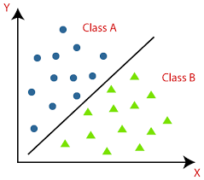
Data Mining Techniques
Supervised Learning - Classification

Slide 10
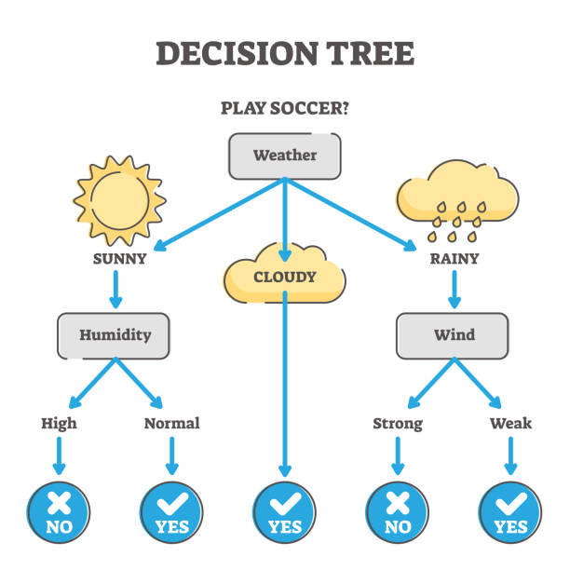
Algorithms
ID3
Good old Decision Tree
C4.5
CART

Slide 11
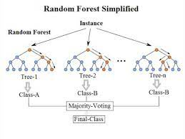
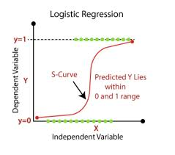
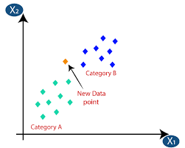
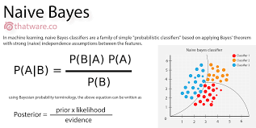
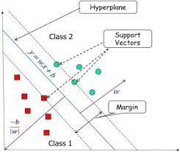
Algorithms
Random Forest
Logistic Regression
K-Nearest Neighbours
We are popular too!
Naive Bayes
Support Vector Machine

Slide 12
Features
Academic
Demographic
Academic Results (current and past)
Time Spent On Studying External Resources
Age
Gender
Attendance
Time Spent In Group Studies
Family Income
Financial Aid (Scholarships)
Tutor Support
Teacher Attributes
Current Health Status
Study
Environment
Distance From Residence To University

Slide 13
Limitations
Results Not Generalizable
Only Student-Centred Approach Considered
Only Traditional Performance Factors Considered
Dataset Imbalance
Small Sample Size

Slide 14
Gap
Analysis

Slide 15
Some less popular features may be required in our dataset
Little information gathering from stakeholders in the past
Context of Bangladesh
Deep learning unnecessary

Slide 16
Objectives

Slide 17

Objectives
Collect academic, demographic, social and behavioural data from students.
Apply machine learning algorithms and select the best one for fine-tuning.

Slide 18
Functional Requirements
Non-Functional Requirements

Slide 19
Functional
Non-Functional
Visual Results
Inference Latency
Confidentiality
Authentication
Model Complexity
Accuracy
Generalization
Deterministic
Interpretability and Explainability
Fairness

Slide 20
Trade Offs

Slide 21
Accuracy
Complexity

Slide 22
Context Diagram

Slide 23
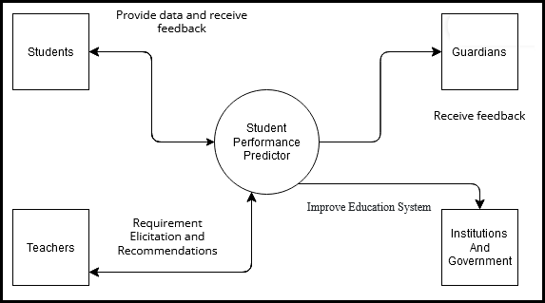

Slide 24
Data Flow Diagram

Slide 25
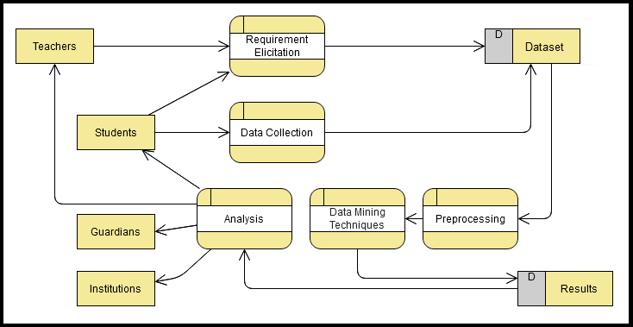

Slide 26
Cost Analysis

Slide 27
COST ANALYSIS
Expenses
Model Infrastructure
Engineering/
Deployment
Data Support

Slide 28
COST ANALYSIS
Revenue
Funds
Customers
Sponsors

Slide 29
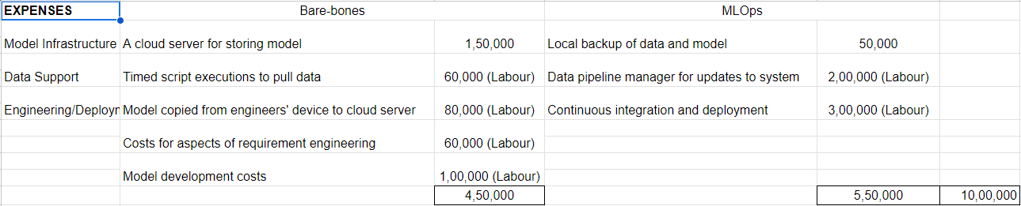
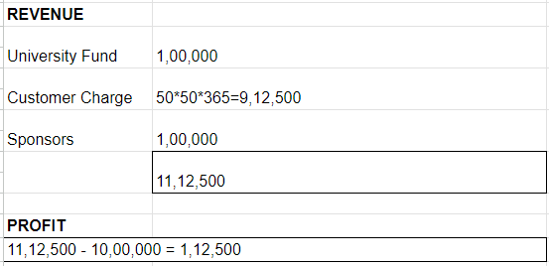
Ref-
https://medium.com/cognifeed/the-cost-of-machine-learning-projects-7ca3aea03a5c

Slide 30
EXPENSES 10,00,000
REVENUE 11,12,500
PROFIT 1,12,500

Slide 31
Project Plan
and
Task Allocation

Slide 32
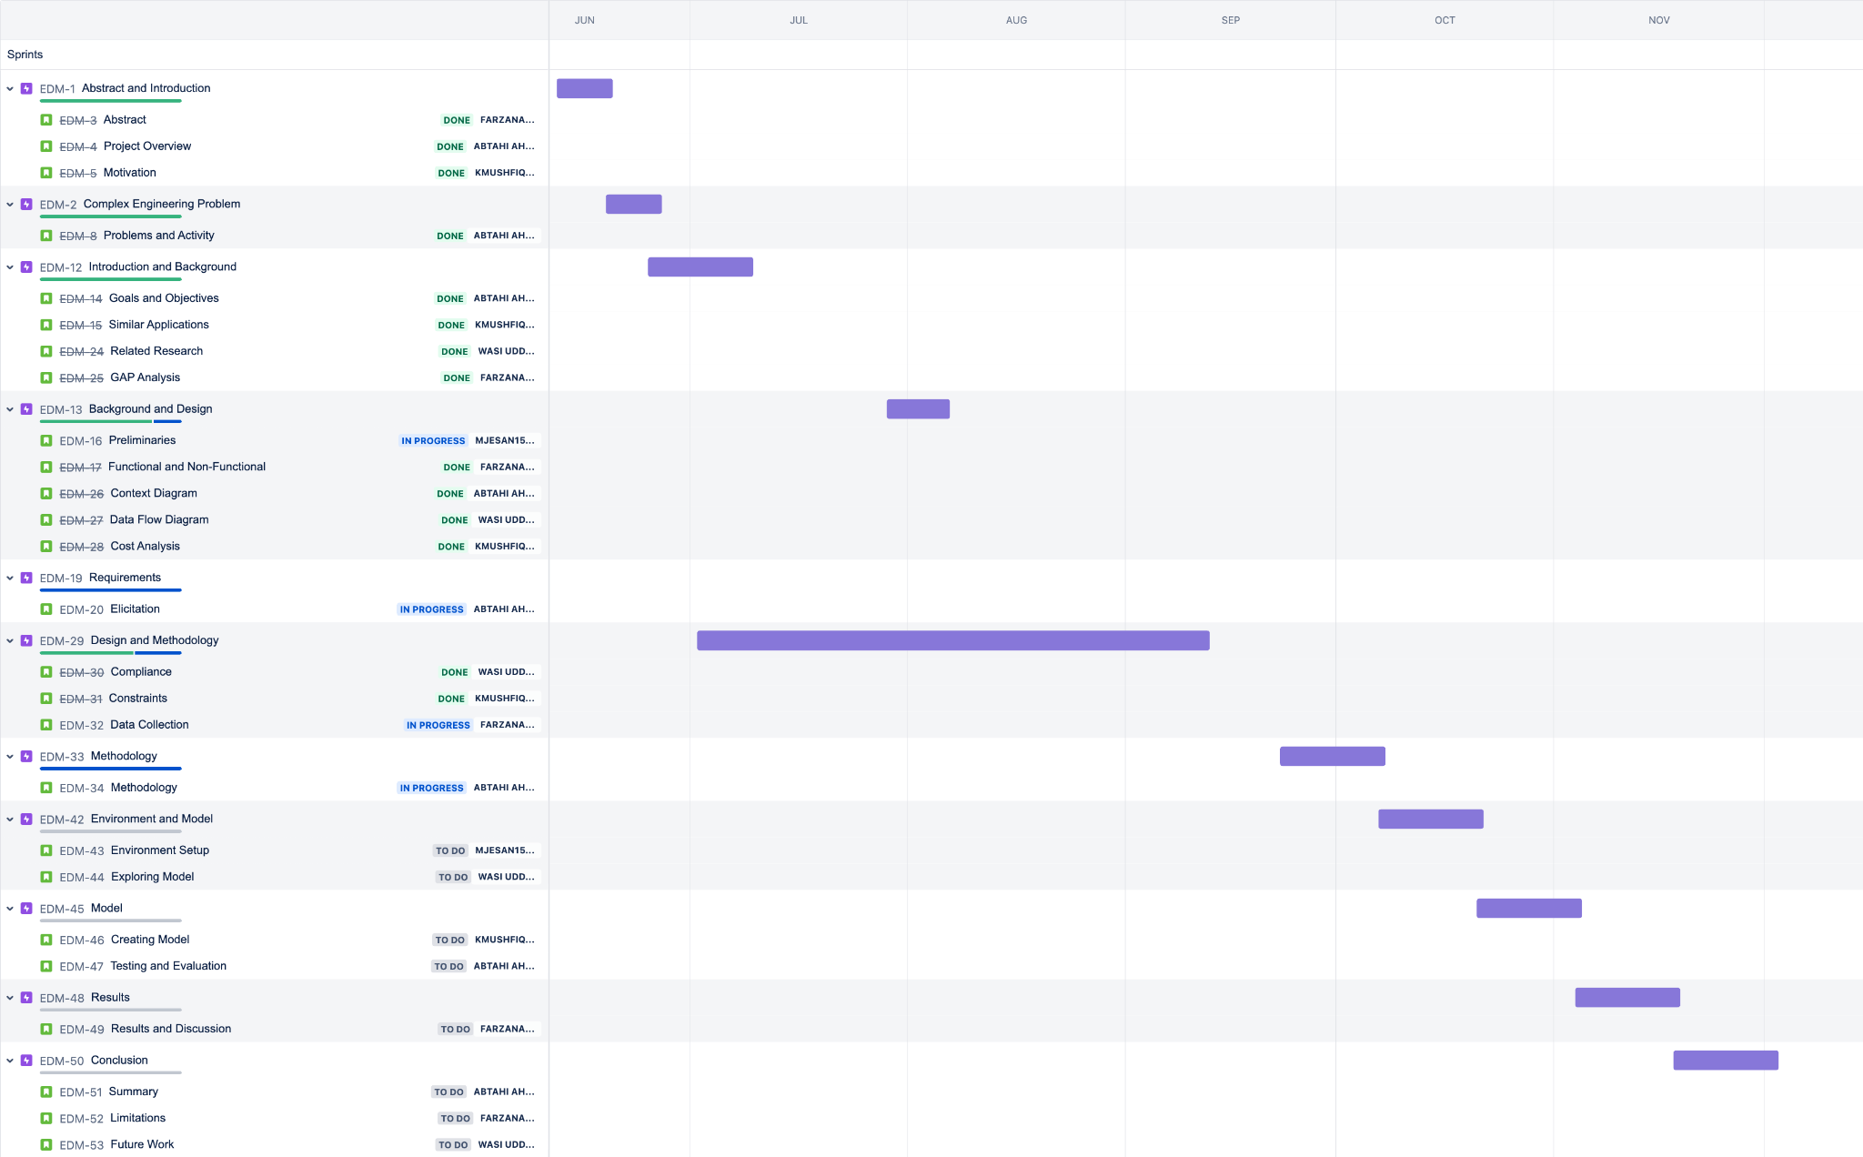

Slide 33
Standards
&
Constraints
Design
Economic
Environmental
Ethical
Health and Safety
Social

Slide 34
Complex Engineering Problem Solving
There are 7 complex engineering problems which determine if a problem can be characterized in a complex manner or not. Our project fulfills 5 of the complex engineering criteria.

Slide 35

Mapping with Complex Problem Solving
P1 | P2 | P3 | P4 | P5 | P6 | P7
Depth of Knowledge | Range of Conflicting Requirements | Depth of Analysis | Familiarity of Issues | Extent of Applicable Codes | Extent of Stakeholder Involvement | Inter- dependence

Slide 36
Thank You

